Slide 1
Theoretical and Practical Study of Robotics
Miguel Ruiz Nogués – S10002540

Slide 2

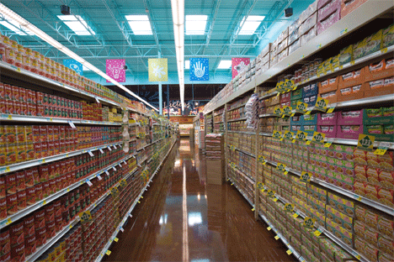
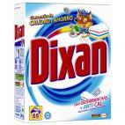
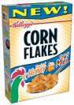
Actual Problem
Detergent or Cereals?
Where is the product?

Slide 3

Solution
“ Build a prototype robot to guide blind people through a supermarket, with a low budget”

Slide 4
Advantages of the Solution
BEFORE:
1) One Disability Person = One trained person
AFTER:
2) One Disability Person = One Robotic Trolley

Slide 5
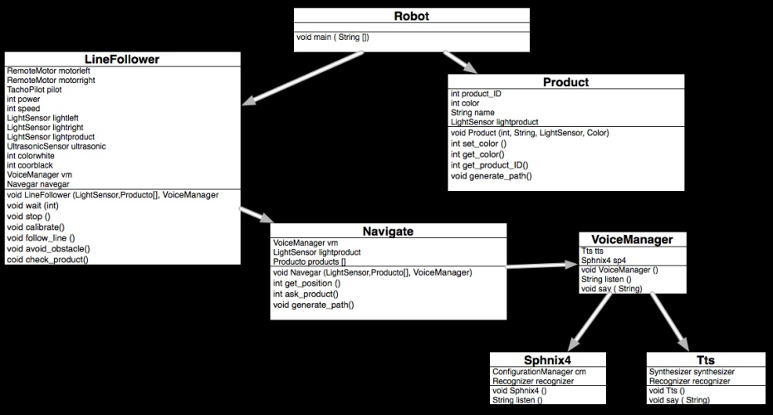
UML
Simple & Effective Solution

Slide 6
Design

Slide 7
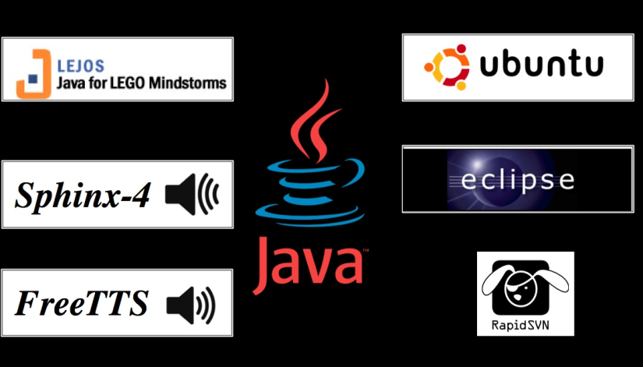
Technology Used

Slide 8

Economic Study
Hardware | Cuantity | Price
NXT Brick | 1 | 158.95 | $
NXT Ultrasonic Sensor | 1 | 32.95 | $
NXT Color Senosr | 3 | 17.95 | $
NXT Motor | 2 | 24.95 | $
Notebook Asus 1005HA | 1 | 250 aprox | $
Bluetooth Headphones | 1 | 10 | $
USB Bluetooth Device | 1 | 5 | $
 | TOTAL: | 560 | $
Software | Price
Ubuntu 10.04 | Free
Java | Free
leJOS | Free
Eclipse | Free
Free TTS | Free
SVN | Free
Sphinx 4 | Free
Objective: Low Budget

Slide 9
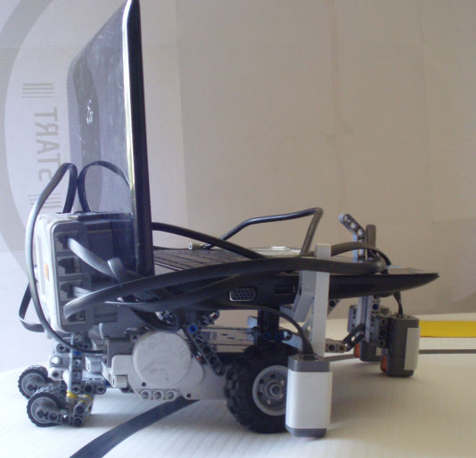
Demonstration
Video: http://www.youtube.com/watch?v=M9NMpGj1L_I

